Slide 1



CSE424 Individual Paper Presentation 2
Presented by
Asief Iqbal Dieyaz
23341081
CSE424
section 1

Slide 2
Overview
1
Summary
1.1
Motivation
1.2
Contribution
1.3
Methodology
1.4
Result
1.5
Conclusion
2
Limitations
3
Synthesis

Slide 3
Summary
Paper Title:
A Hybrid Approach for Human Activity
Recognition with Support Vector Machine and 1D
Convolutional Neural Network
Md Maruf Hossain Shuvo, Nafis Ahmed, Koundinya Nouduri, Kannappan Palaniappan
Human Activity Recognition (HAR) in sensor data
Objective: Enhance accuracy with hybrid model
Challenges: Noisy data, individual variations

Slide 4
Motivation
Importance & Complexity of HAR task
Improve accuracy and adaptability
Introduce hybrid SVM-CNN model
Combined ML-ANN approach boosts recognition

Slide 5
Contribution
Primary Contribution: Two-stage learning process
RF Classification: Static vs. moving activities
SVM and 1D CNN: Adaptive recognition

Slide 6
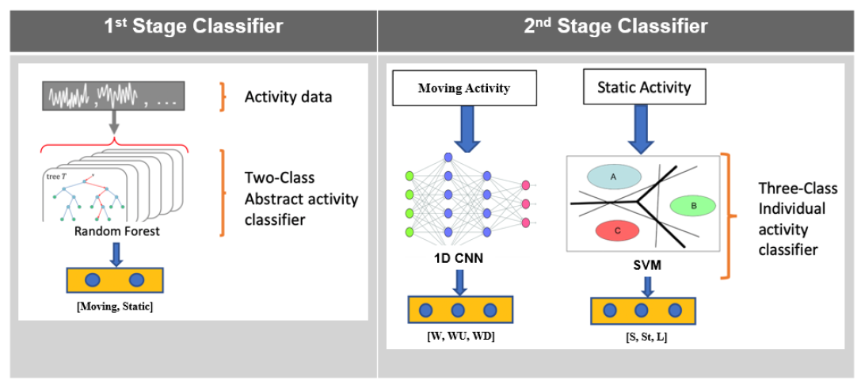
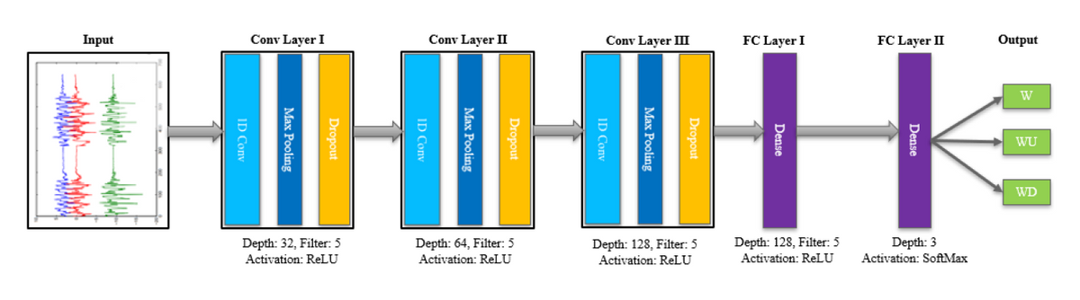
Methodology
Two-Stage Learning: RF, SVM, 1D CNN
RF: Classify static and moving
SVM: Recognize static activities
1D CNN: Capture local dependencies in moving activities

Slide 7
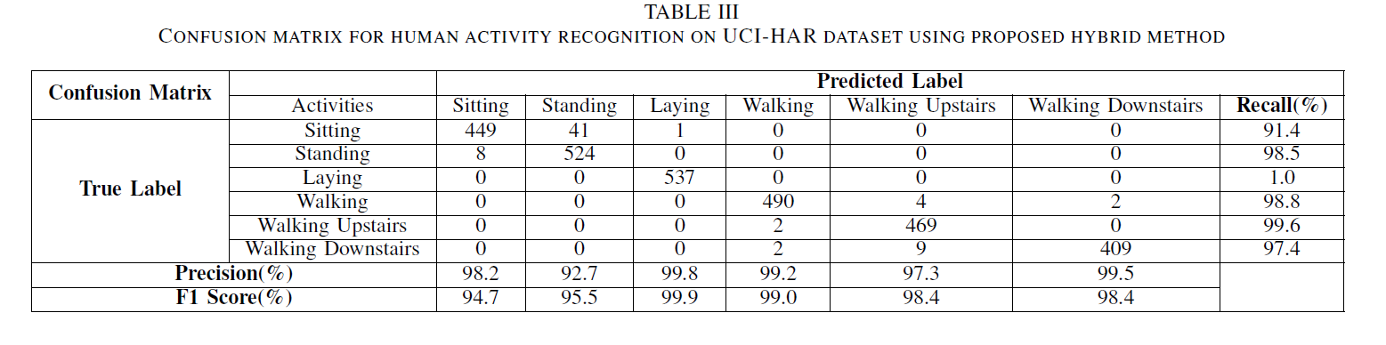
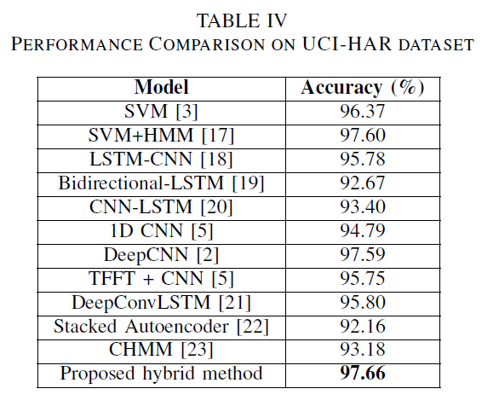
Result

Slide 8
Conclusion
Achieved an overall accuracy of 97.71%
Tuned for optimal performance
Training Strategies: Early stopping, model checkpointing
Partially supported by awards from U.S. NIH National Institute of Neurological Disorders and Stroke, and the U.S. Army Research Laboratory project

Slide 9
Limitations
1st Limitaion
Computational complexity
2nd limitation
Reliance on specific dataset (UCI-HAR)

Slide 10
Synthesis
Success of Hybrid Model: Balancing classical ML and DL
Real-World Applications: Wearable sensors, assistive living
Future Research: Broader datasets, computational optimizations
Conclusion: Promising hybrid model for HAR advancements

Slide 11
Thank
You

